Slide 1
BIT 6113
Database Management System
Sushil Bhattarai
sushil.bhattarai@texascollege.edu.np
Lincoln University College, CN 1221

Slide 2
Entity Relationship Model
An ERD shows the relationships of entity sets stored in a database, graphically.
Entity in a database could be a single person, place, or thing about which data can be stored.
Each entity has a set of properties. The properties of each entity are termed as attributes. Eg. Student can be an entity and would be described by attributes such as RollNumber, Semester, Address etc.
Relationships are meaningful associations between or among entities.
Relationships are represented as lines connecting the points and shapes.
 | A rectangle represents an Entity. |  | One To One
 | An oval represents an Attribute. |  | One To Many
 | A diamond represents Relationship. |  | Many To Many
Entity Relationship Model
2
Notes:
2

Slide 3
Entity Relationship Model for a College
Name
Class
Name
University
Roll
Address
Address
Admit
Student
College
Name
Has
Location
College
Departments
HOD
Name
Offers
Subject
Department
Courses
Intake
Study
Student
Courses

Slide 4
Entity Relationship Model for a College
Name
Class
Name
University
Roll
Address
Address
Admit
Student
College
Has
Name
Location
Study
Departments
HOD
Offers
Name
Courses
Subject
Intake

Slide 5
Entity Relationship Model for an online store
Places
Customer
Order
includes
Order
Product
Sales
Supplier
Product

Slide 6
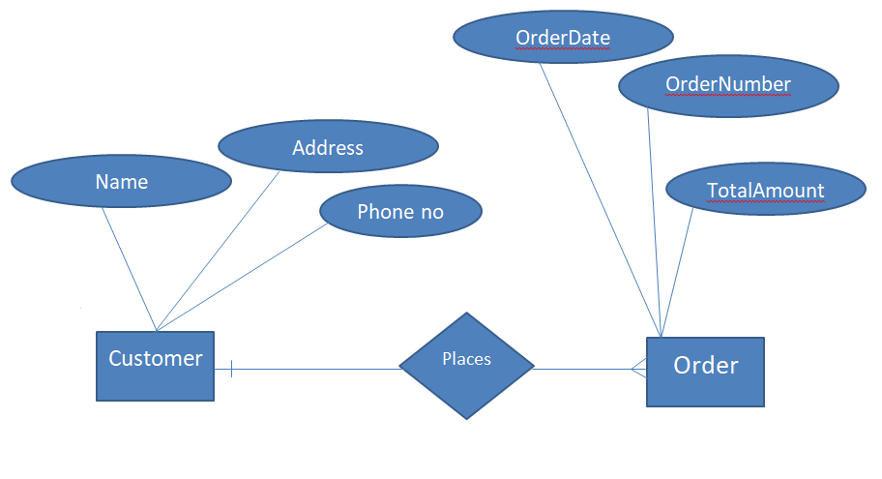
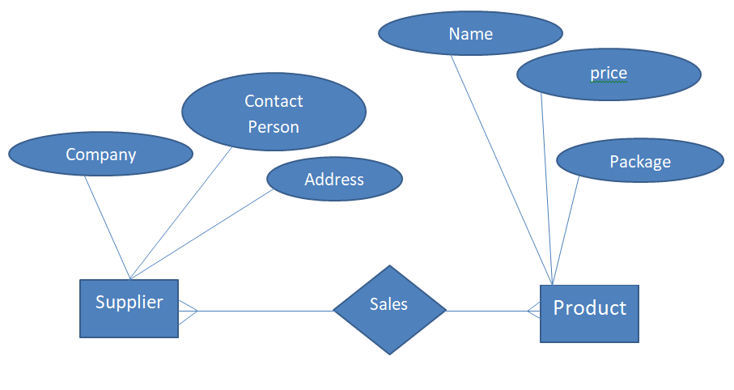
Entity Relationship Model for an online store
Entity Relationship Model
6
Notes:
6

Slide 7
Entity Relationship Model
Customer
Place
Order
Includes
Sale
Supplier
Product
Entity Relationship Model
7
Notes:
7

Slide 8
Assignment
The database for an Airline should store details about an airline’s fleet, flights, and seat bookings. Prepare an ER Diagram, based on following requirements.
An airplane has a model number, a unique registration number, and the capacity to take one or more passengers.
An airplane flight has a flight number, a departure airport, a destination airport, a departure date and time, and an arrival date and time.
Each flight is carried out by a single airplane.
A passenger has given names, a surname, and a unique email address.
A passenger can book a seat on a flight.
Assignment
8

Slide 9
Flies
Airplane
Flight
book
Passenger
Seat
include
Flight
Seat

Slide 10
Assignment
Prepare an ER Diagram for a system in a Hospital with Entities Doctor, Patient, Nurses, Medicines, etc. The diagram should show the Entities, Attributes and Relationships.
Prepare an ER Diagram for a system in a library with Entities like Librarian, Books, Reader and Fine showing the Attributes and Relationships among them.
Assignment
10

Slide 11
Importance of ER Diagram
Database design: ER diagrams are used to model and design relational databases, in terms of logic and business rules.
Database troubleshooting: ER diagrams are used to analyze existing databases to find and resolve problems.
Requirements Gathering : This helps the users to plan how to organize data
Documentation Tool : ER Diagrams can work as a documentation to make others understand the core of the database.
Business process re-engineering (BPR): ER diagrams help in analyzing databases used in business process re-engineering and in modeling a new database setup.
Research: ER diagrams can play a key role to analyze the data.

Slide 12
Disadvantages of E-R Data Model
No industry standard for notation: There is no industry standard notation for developing an E-R diagram.
high-level design: The E-R data model is especially popular for high level and gives a high level overview.

